Slide 1
Lab 4
Abstract class & Regex validation

Slide 2


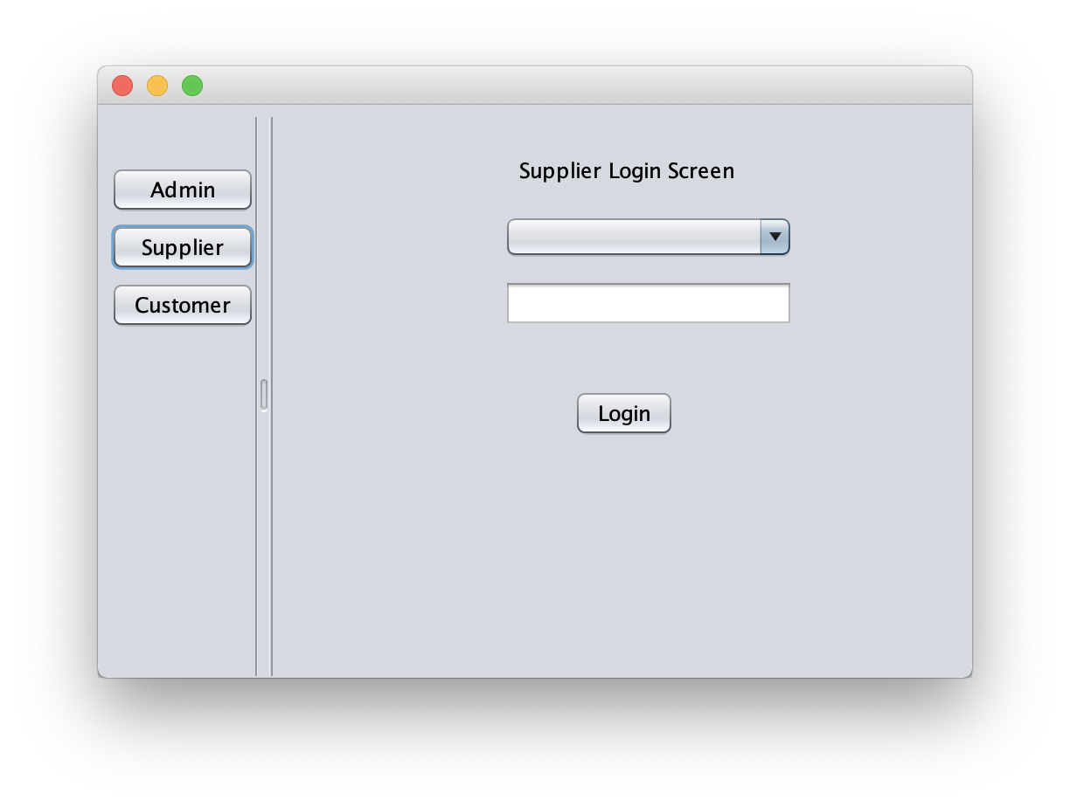
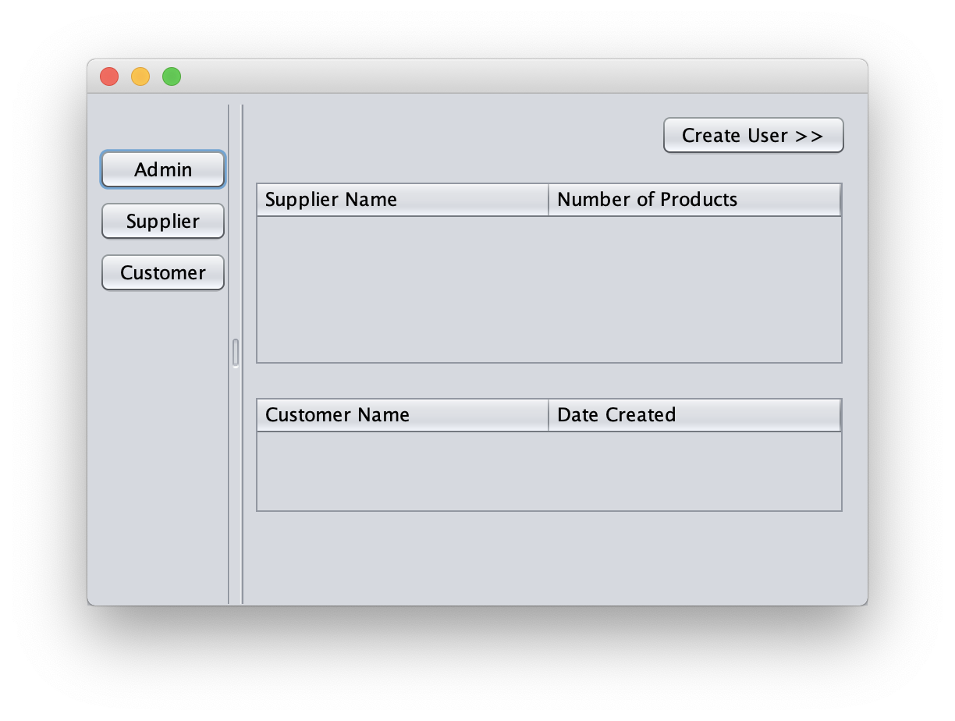



Supplier & Customer App

Slide 3
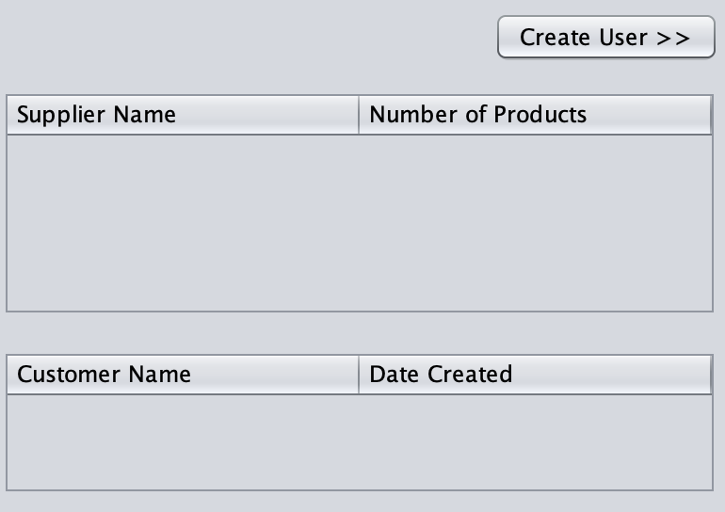
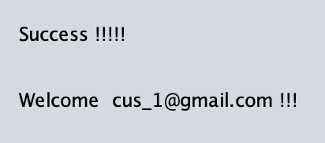
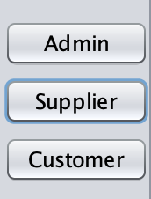
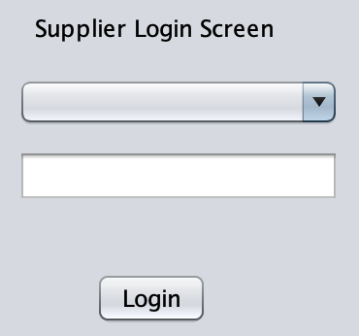
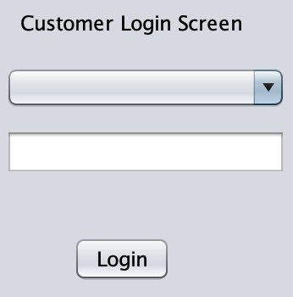
AdminMainScreen
SuccessScreen
LoginScreen
LoginScreen

Slide 4
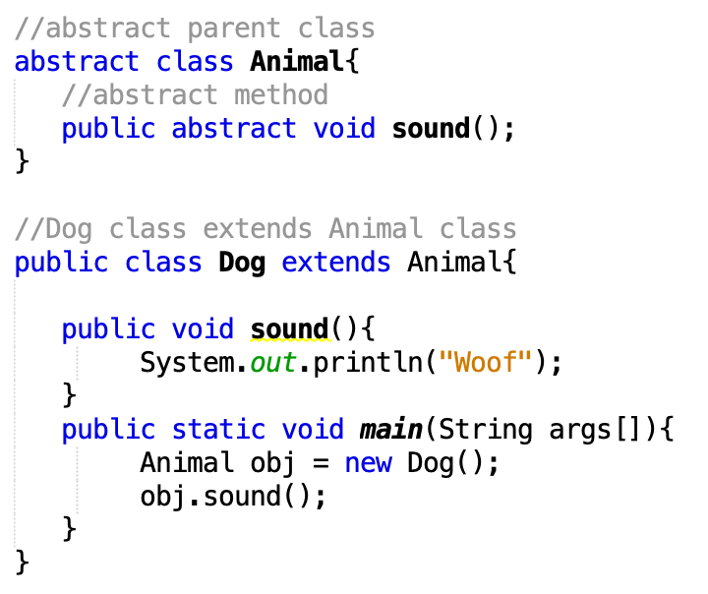
Abstract Class and Methods
Abstract Class User
extends
Admin
Supplier
Customer
Notes:
Show abstract structures of the project

Slide 5
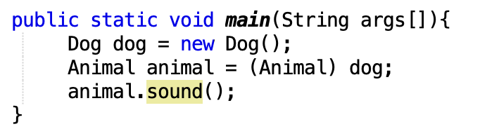
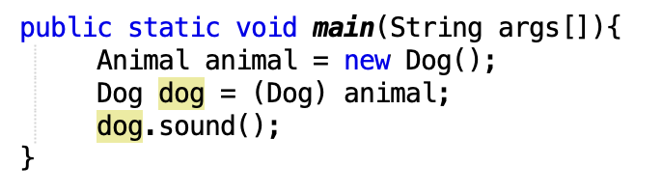
Upcasting and Downcasting
Upcasting is casting a subtype to a supertype, upward to the inheritance tree.
Downcasting is casting to a subtype, downward to the inheritance tree.

Slide 6
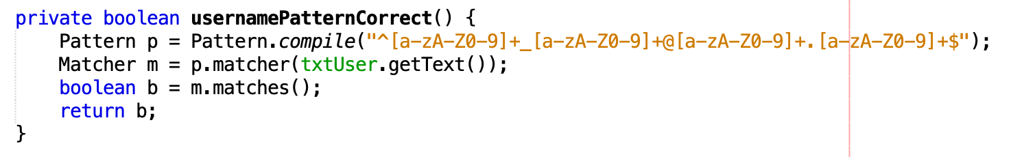
Regex Validation
^ | Start of string or start of line depending on multiline mode. (But when [^inside brackets], it means "not")
$ | End of string or end of line depending on multiline mode. Many engine-dependent subtleties.
[x-y] | One of the characters in the range from x to y
[^x-y] | One of the characters not in the range from x to y
+ | One or more
* | Zero or more times
Format: xx_xx@xx.xx

Slide 7

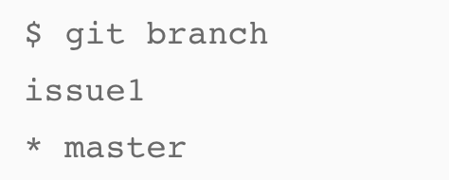
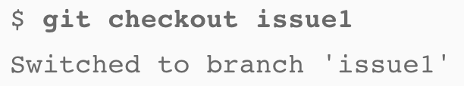
Git – Multiple branches
Create a new branch named issue1.
Show which branch you are currently on
Switch branch
Create Pull Request and merge into master branch after Pushing
https://confluence.atlassian.com/bitbucket/create-a-pull-request-to-merge-your-change-774243413.html

Slide 8
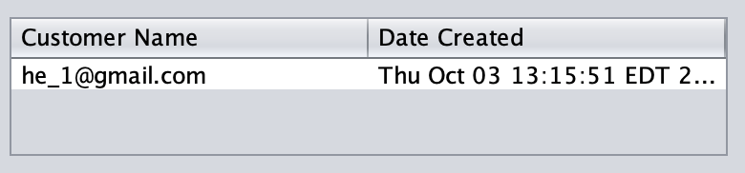
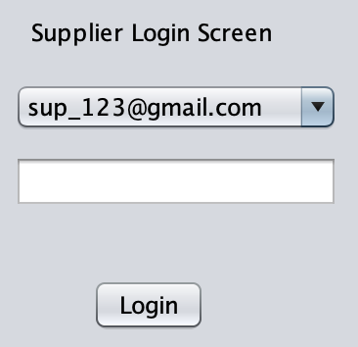
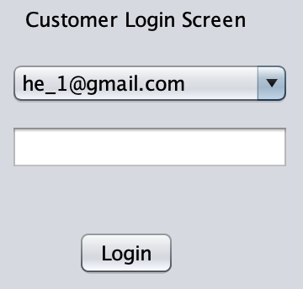
Homework (continue)
Finish the customer login
Finish the population of customer table on AdminMainScreen
Customize the initialize () method in LoginScreen class so that login screen shows either customer usernames or supplier usernames depends on role of user logging in. (Customer and Supplier should use the same loginJPanel for login)

Slide 9
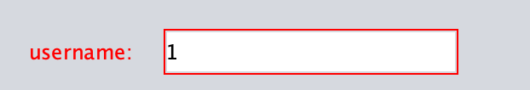
Homework (continue)
Add regex validation for username and password during both supplier and customer creation by using Pattern and Matcher: 1. Username should be in the format of xx_xx@xx.xx (eg. a_1@gmail.com, aa_aaa@yahoo.com) 2. Password should be at least 6 digits and contain at least one upper case letter, one lower case letter, one digit and one special character $, *, # or &.
Set unproper credential red during account creation.
Due Date: Sat, Oct 12th, 11:59pm on BitBucket

Slide 10
Homework
Git requirements:
No direct commits on master branch.
Commit on a new branch
Create pull request and merge into master branch.
Multiple small commits.
Due Date: Sat, Oct 12th, 11:59pm on BitBucket

